Slide 1



Let the Data Flow While You Take It Slow
By: Alexander (aj) Truby-Arena

Slide 2




ABOUT ME
Finding PeopleShores
During the program
Becoming a parent
Applying to every tech job
Opportunity
My wife and I found out we are going to be first time parents. Needing to find growth for my growing family, I started applying to any and every job tech related. PeopleShores called and having an opportunity to get in a field that is normally attained through a degree was life changing.
I came into this knowing very little about programming. It was intimidating. But my favorite part about this program is the people and support to succeed. I ask a lot of questions, and I have never been turned away or felt like I was asking too many questions.
Marine Corps Veteran - Radio Technician
HVAC – Building/installing duct work
Dish Network - Field Technician
Honeywell Inc. - Test Technician
PeopleShores - Jr Data Engineer
So, what did I learn?
I learned the fundamentals of programming, how to write code, and solve problems. But more importantly, I will always be a student.

Slide 3
Quotes
“Time you enjoy wasting is not wasted time.” — Marthe Troly-Curtin
“Time is the only currency we're born with, spend constantly, and can never earn back. So, ask yourself, is what you're buying worth the cost?”– Alexander Truby-Arena

Slide 4

So why does Time matter?
Well, my job is to spend my time to save you time.
So, how do I do that?

Slide 5

workflow
Create Spark Session

Slide 6

workflow
Extracting Files
Files
You
Your code
Create Spark Session

Slide 7

workflow
Create Spark Session
Transform using pyspark
Extracting Files
Files
You
Your code

Slide 8

workflow
Create Spark Session
Transform using pyspark
Extracting Files
Files
You
Your code
Create database and tables using mysql.connector
M a g i c

Slide 9

workflow
Create Spark Session
Transform using pyspark
Extracting Files
Files
You
Your code
Create database and tables using mysql.connector
M a g i c
Creating a CLI (command line interface) to easily access the data

Slide 10

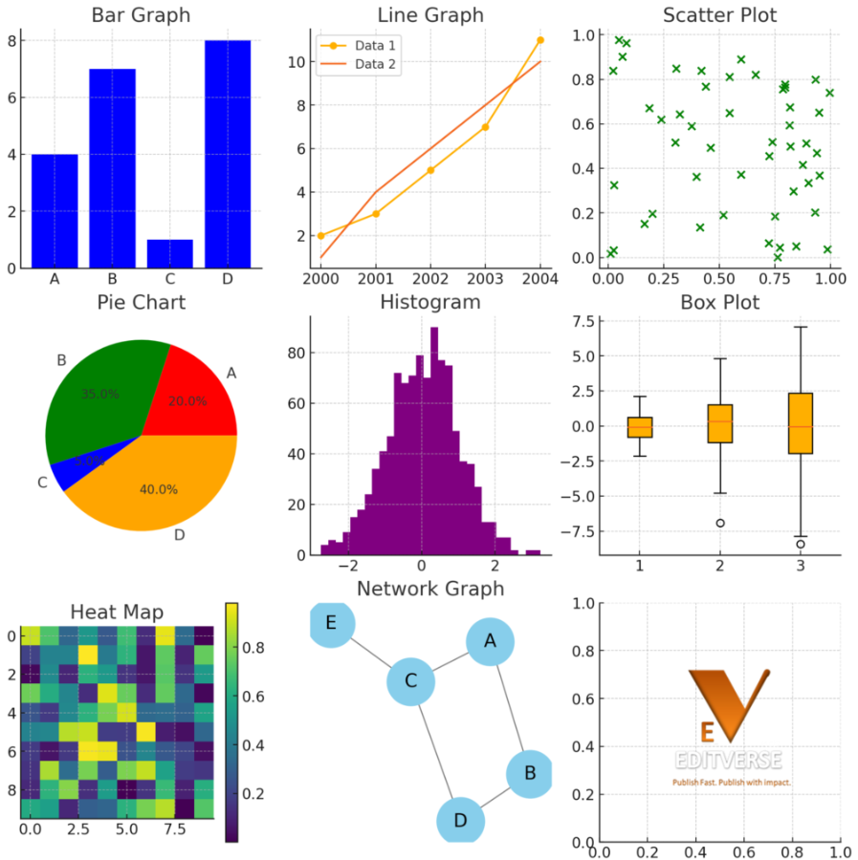
workflow
Create Spark Session
Transform using pyspark
Extracting Files
Files
You
Your code
Creating a CLI (command line interface) to easily access the data
Create database and tables using mysql.connector
M a g i c
Creating Visualizations
Such pretty pictures!

Slide 11
workflow
Create Spark Session
Transform using pyspark
Extracting Files
Files
You
Your code
Creating Visualizations
Creating a CLI (command line interface) to easily access the data
Create database and tables using mysql.connector
Such pretty pictures!
M a g i c

Slide 12
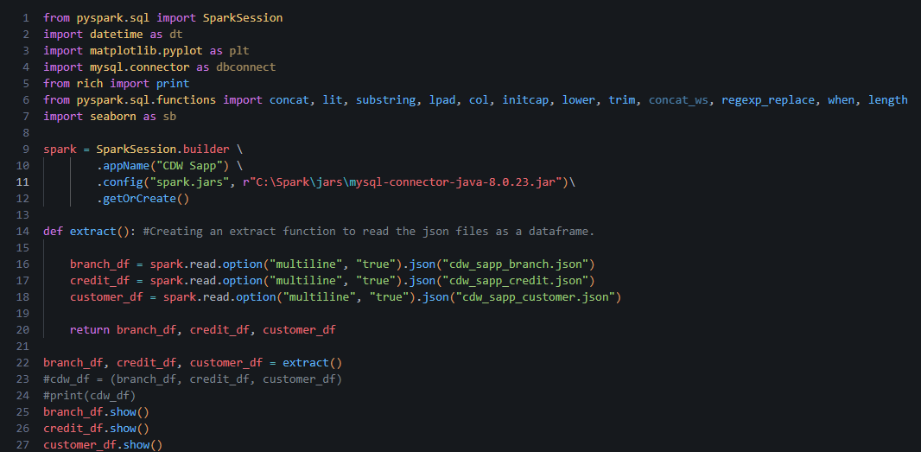
Extracting the JSON Files

Slide 13
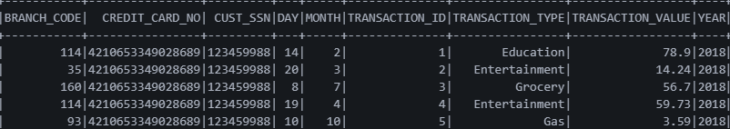
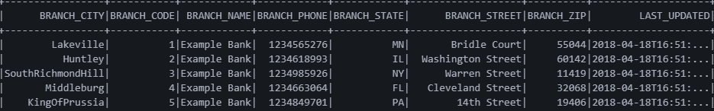
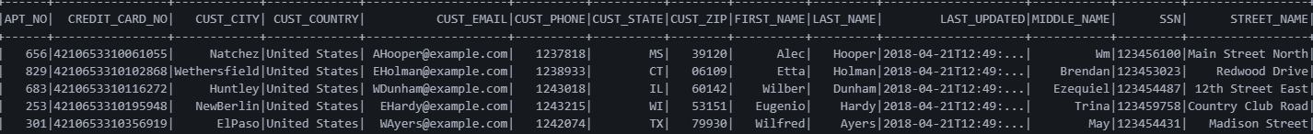
Output

Slide 14
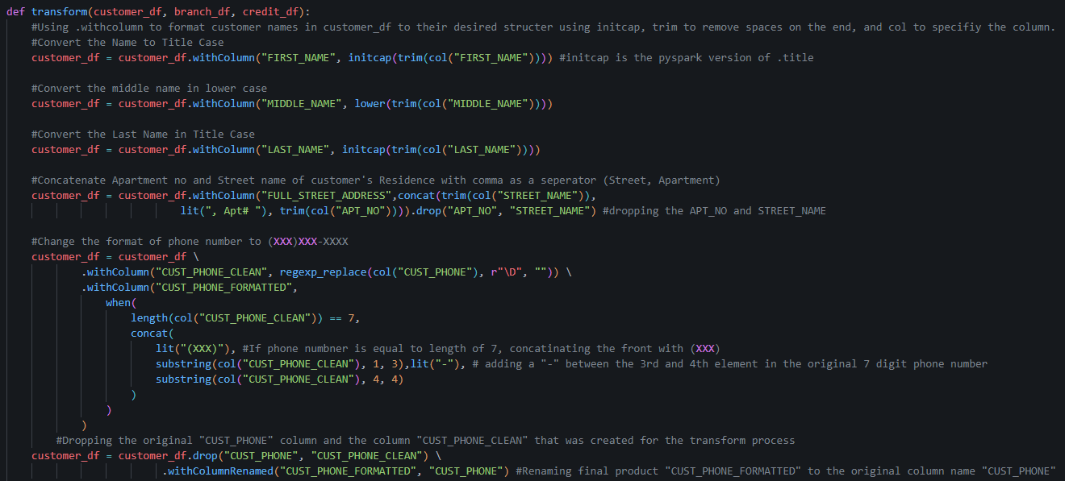
Customer Transform

Slide 15
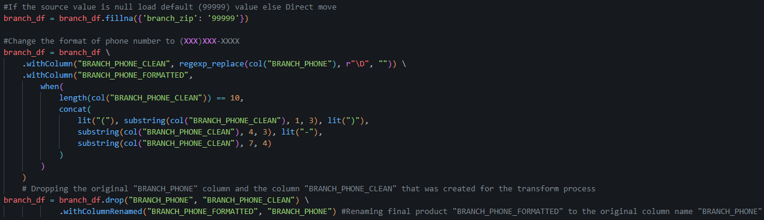
Branch Transform

Slide 16
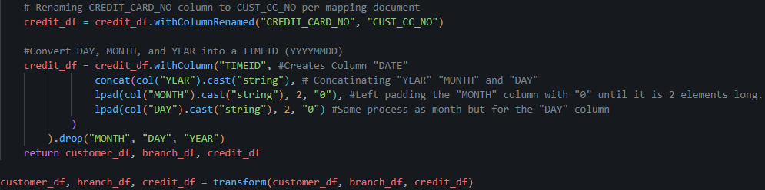
Credit transform

Slide 17
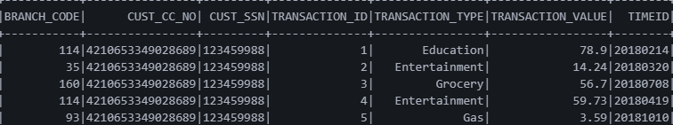
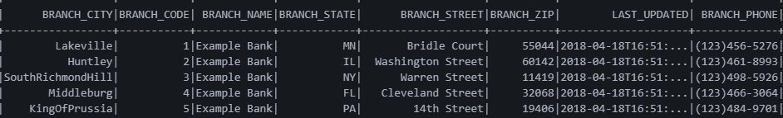
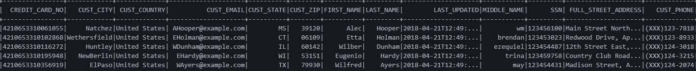
Output

Slide 18
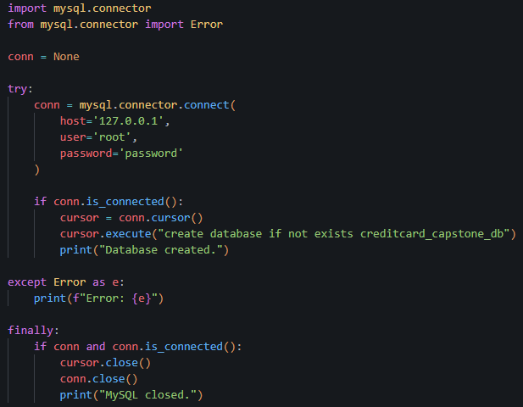
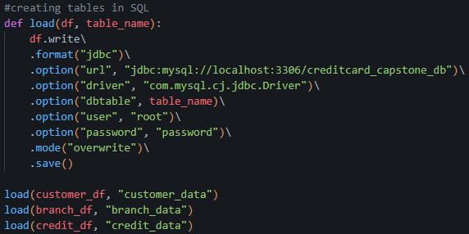
Connecting to MySQL/ Creating Database and tables with load function

Slide 19
So, what’s the purpose?
We saw a bunch of code that may seem like a lot.
Well, the code you saw helps transform (clean) data from a raw format to a more readable, user friendly, format.
So, what can we do with the data that we just cleaned?

Slide 20
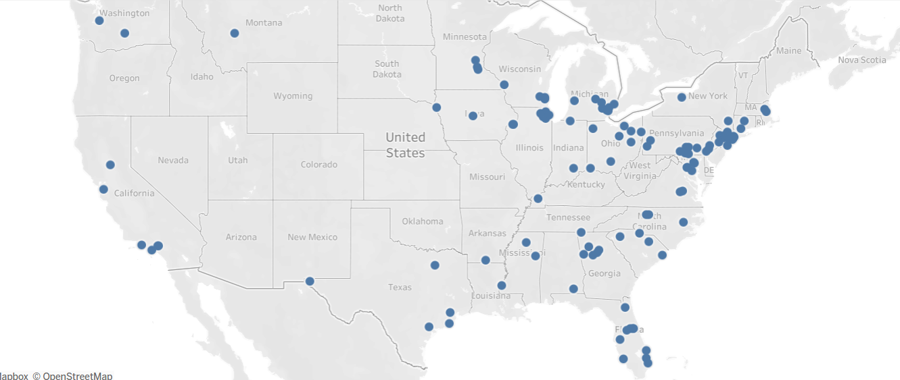
Branch Locations by City

Slide 21
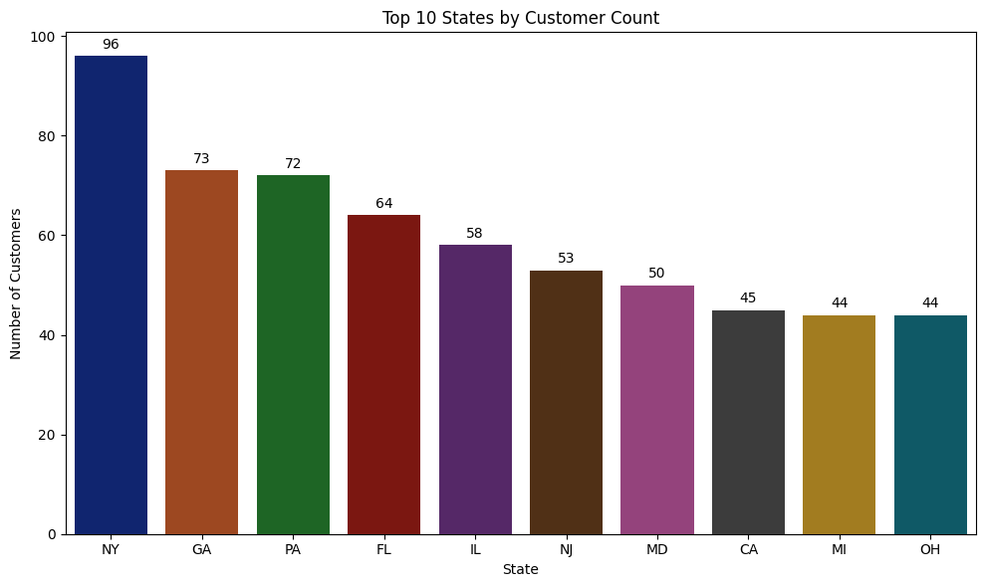
Top 10 states by customer count

Slide 22
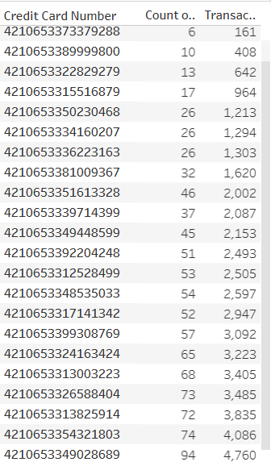
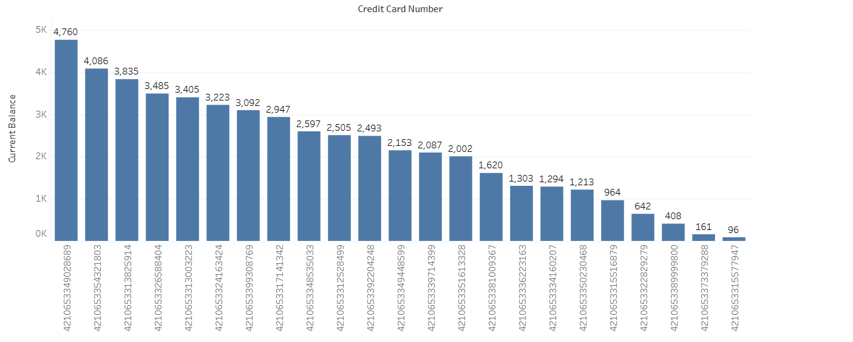
Transaction count vs balance
Balance for each account

Slide 23
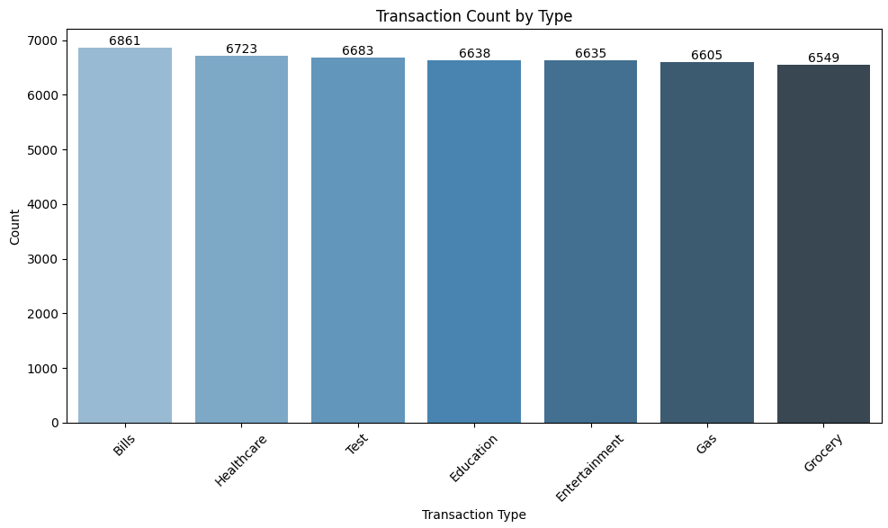
How many transactions for each transaction type

Slide 24
Challenges and Learning
I came into programming not knowing much.
Learning new tools
Solving problems
Originally, I was going to use Regex for formatting customer phone number, but I learned that pyspark does not support regex.

Slide 25

Conclusion
All this to circle back around to my first couple slides.
I spent months learning and growing so I can create effective programs so I can save you, a client, or anyone else time and prevent wasted time with ease of use.
“There is nothing worse than not enjoying the time you are wasting”- Alexander Truby-Arena

Slide 26


FIN

